Slide 1
Image Classification
Elif, Nikesh and Deepak

Slide 2
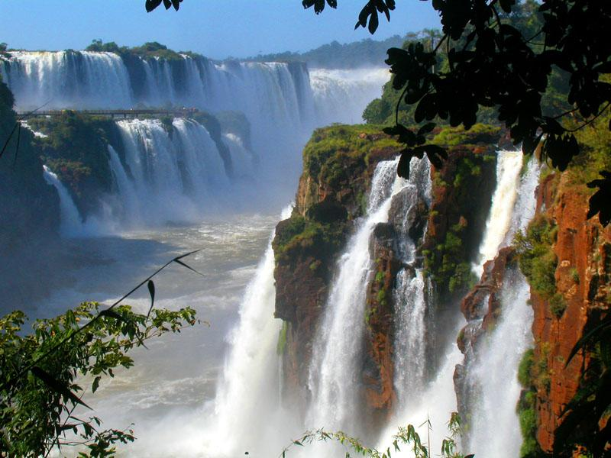

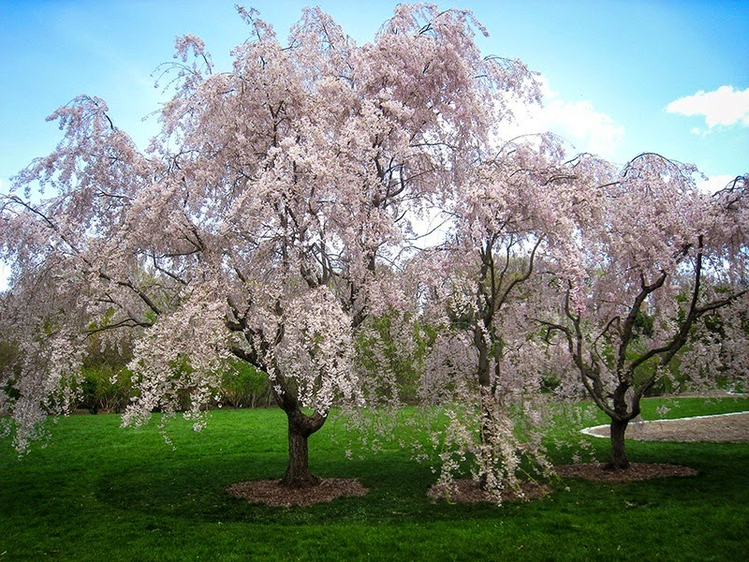
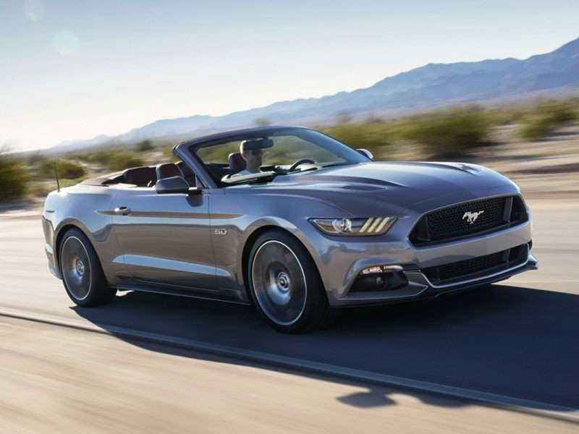
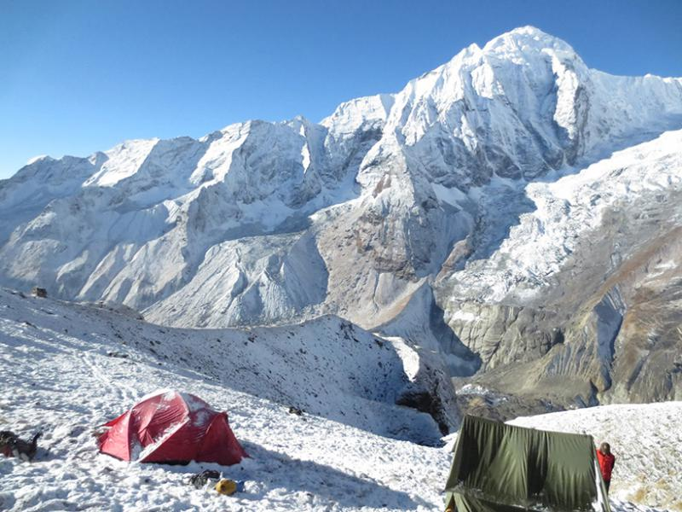
5 Categories

Slide 3
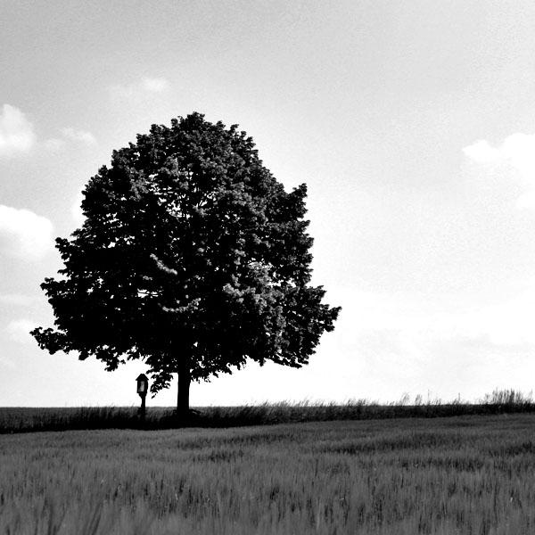
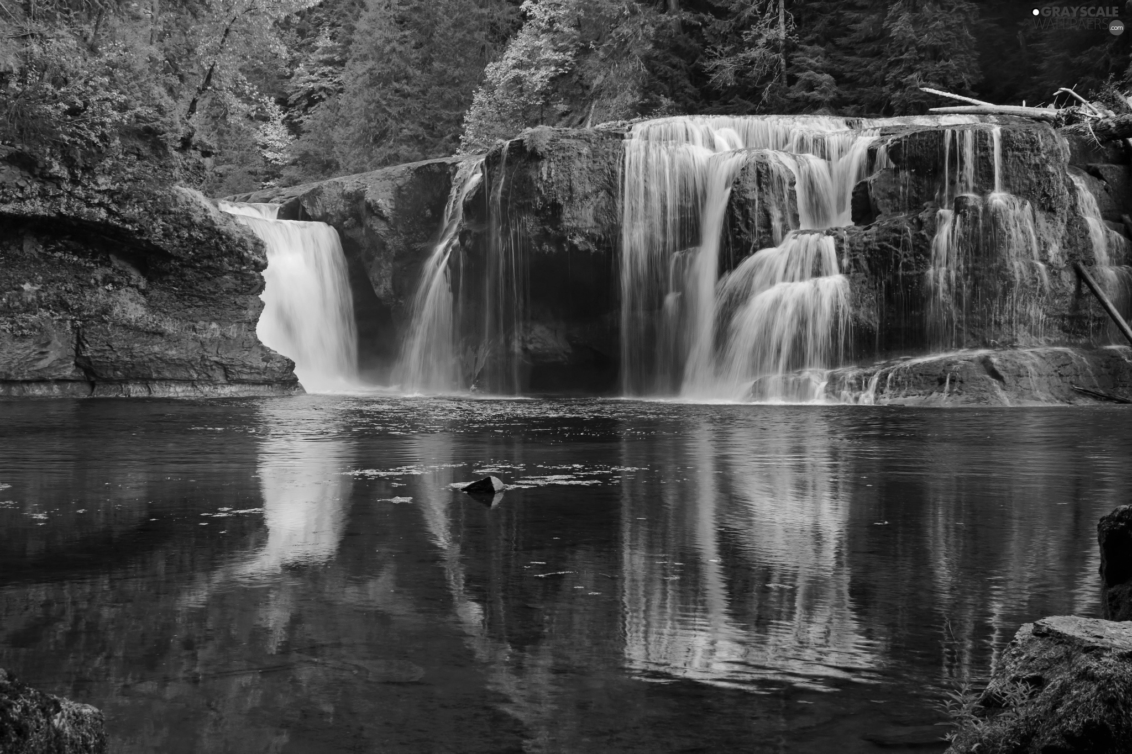
Grayscale Conversion
gray_pixels <- function(Image) {
im <- load.image(Image)
gray <- grayscale(im)
resize.im <- resize(gray, w=200, h=200)
mat <- matrix(resize.im, nrow=1)
return(mat)
}

Slide 4
Algorithms Used:
Dimension Reduction
Support Vector Machine

Slide 5
Progress
10 Images each/per class
Error Now: 55%
Link to Results: https://goo.gl/KvR7Ev

Slide 6
Future Improvement
Increase Images in Training Set
Use Support Vector Machine with Linear and Polynomial Kernel
Try a Binary Classification

